Slide 1
Nonclassicality, quasiprobabilities and weak values explored in neutron interferometry
Ismaele Vincent Masiello
Neutron and Quantum Physics
Atominstitut
TU Wien, Austria

Slide 2
Motivation and goal
Quantum mechanics exhibits features with no classical counterpart.
However, not all quantum experiments exhibit non-classical features and identifying the classical/quantum boundaries is of importance.
We are interested in experimental tools to probe such boundaries.

Slide 3
Overview
Classical and quantum Preparation-Measurement scenarios
Quasiprobability representations and weak values
Experimental results

Slide 4
Disclaimer: not all experiments are this simple

Slide 5
Preparation and Measurement
Preparation (P)
Measurement (M)
1
2
3
t
1
2
3
...
n
System
Outcome probabilities:

Slide 6
A classical experiment
Preparation (P)
Measurement (M)
1
2
3
...
n
System
Defined set of properties:

Slide 7
A classical experiment
Preparation (P)
Measurement (M)
1
2
3
...
n
System
Defined set of properties:

Slide 8
A classical experiment
Preparation (P)
Measurement (M)
1
2
3
...
n
100%
System
100%
Outcome probabilities:

Slide 9
A classical experiment
Preparation (P)
Measurement (M)
1
2
3
...
n
15%
75%
10%
System
75%
25%

Slide 10
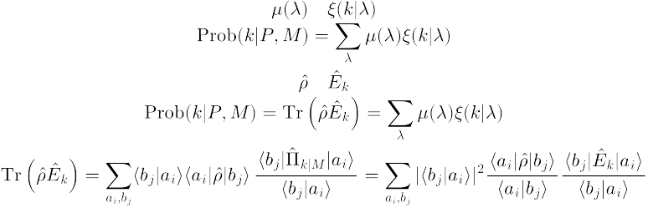
A classical experiment
Probability distribution:
Response function:
Preparation (P)
Measurement (M)
1
2
3
...
n
15%
75%
10%
System
75%
25%

Slide 11
A classical experiment
Probability distribution:
Response function:
Preparation (P)
Measurement (M)
1
2
3
...
n
15%
75%
10%
System
75%
25%
Outcome probabilities:

Slide 12


A quantum experiment
Preparation (P)
Measurement (M)
1
2
3
...
n
System
Set of undefined properties:

Slide 13

A quantum experiment
Pure state:
Projective measurement:
Preparation (P)
Measurement (M)
1
2
3
...
n
System
100%

Slide 14

A quantum experiment
Pure state:
Projective measurement:
Preparation (P)
Measurement (M)
1
2
3
...
n
25%
75%
System
100%
Outcome probabilities:

Slide 15
Can my experiment be reproduced classically?

Slide 16
Can my experiment be reproduced classically?
Outcome probabilities:
?

Slide 17

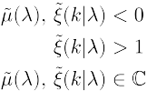
Quasiprobability representations
Quasiprobability representations:
Anomalous features:
Ferrie, Christopher. "Quasi-probability representations of quantum theory with applications to quantum information science." Reports on Progress in Physics 74.11 (2011): 116001.

Slide 18
Quasiprobability representations
Quasiprobability representations:
Quasiprobability
distribution
Anomalous features:
Ferrie, Christopher. "Quasi-probability representations of quantum theory with applications to quantum information science." Reports on Progress in Physics 74.11 (2011): 116001.

Slide 19
Quasiprobability representations
Quasiprobability representations:
Quasiprobability
distribution
Symbol
Anomalous features:
Ferrie, Christopher. "Quasi-probability representations of quantum theory with applications to quantum information science." Reports on Progress in Physics 74.11 (2011): 116001.

Slide 20
Quasiprobability representations
Two orthonormal basis:
Kirkwood-Dirac quasiprobability representation:

Slide 21
Quasiprobability representations
Two orthonormal basis:
Kirkwood-Dirac quasiprobability representation:
Weak value
..and we can measure it!

Slide 22
Quasiprobability representations
Two orthonormal basis:
Kirkwood-Dirac quasiprobability representation:
Weak values!
..and we can measure them!

Slide 23
Weak values
Weak measurement:
A meter state
A weak interaction
Aharonov, Yakir, et al. "How the result of a measurement of a component of the spin of a spin-1/2 particle can turn out to be 100." Physical review letters 60.14 (1988): 1351.

Slide 24
Weak values extraction in neutron interferometry
Meter state and weak interaction:
Lemmel, Hartmut, et al. "Quantifying the presence of a neutron in the paths of an interferometer." Physical Review Research 4.2 (2022): 023075.
Danner, Armin, et al. "Simultaneous path weak-measurements in neutron interferometry." Scientific Reports 14.1 (2024): 25994.
Dvorak, Andreas, et al. "Tight qubit uncertainty relations studied through weak values in neutron interferometry." Physical Review Research 7.4 (2025): 043334.

Slide 25
Weak values extraction in neutron interferometry
Meter state and weak interaction:
Lemmel, Hartmut, et al. "Quantifying the presence of a neutron in the paths of an interferometer." Physical Review Research 4.2 (2022): 023075.
Danner, Armin, et al. "Simultaneous path weak-measurements in neutron interferometry." Scientific Reports 14.1 (2024): 25994.
Dvorak, Andreas, et al. "Tight qubit uncertainty relations studied through weak values in neutron interferometry." Physical Review Research 7.4 (2025): 043334.
Meter state and no weak interaction:
Denkmayr, Tobias, et al. "Weak values from strong interactions in neutron interferometry." Physica B: Condensed Matter 551 (2018): 339-346.
No meter state and weak interaction:
Masiello, Ismaele V., et al. "Simultaneous determination of two path weak-values with time-dependent phase manipulation in neutron interferometry." New Journal of Physics 27.2 (2025): 023017.

Slide 26
Weak values extraction in neutron interferometry
Meter state and weak interaction:
Lemmel, Hartmut, et al. "Quantifying the presence of a neutron in the paths of an interferometer." Physical Review Research 4.2 (2022): 023075.
Danner, Armin, et al. "Simultaneous path weak-measurements in neutron interferometry." Scientific Reports 14.1 (2024): 25994.
Dvorak, Andreas, et al. "Tight qubit uncertainty relations studied through weak values in neutron interferometry." Physical Review Research 7.4 (2025): 043334.
Meter state and no weak interaction:
Denkmayr, Tobias, et al. "Weak values from strong interactions in neutron interferometry." Physica B: Condensed Matter 551 (2018): 339-346.
No meter state and weak interaction:
Masiello, Ismaele V., et al. "Simultaneous determination of two path weak-values with time-dependent phase manipulation in neutron interferometry." New Journal of Physics 27.2 (2025): 023017.

Slide 27
Weak values extraction in neutron interferometry
Meter states or weak interactions increase
the experimental complexity!
The manipulation of additional degrees of freedom increases the amount of required experimental resources, while weak interactions typically increase measurement and calibration times due to the limited information gained per detection event.

Slide 28
Weak values extraction in neutron interferometry
Meter states or weak interactions increase
the experimental complexity!
The manipulation of additional degrees of freedom increases the amount of required experimental resources, while weak interactions typically increase measurement and calibration times due to the limited information gained per detection event.
No meter state and no weak interaction:
Masiello, Ismaele V., et al. "Anomalous weak values in a generalized Mach-Zehnder interferometer extracted directly from intensity measurements." arXiv:2606.24798v1 - in review at npj Quantum Information.

Slide 29

Neutron interferometry
Neutron Mach-Zehnder interferometer:

Slide 30
Neutron interferometry
Why neutron interferometry?
Interference is intrinsically a single-massive-particle phenomenon.
Matter-wave interferometry at room temperature and ambient pressure, with macroscopic beam separation and high contrast.
Manipulation of several degrees of freedom (path, spin, energy) and interaction with all known forces.
Sponar, S., Sedmik, R. I., Pitschmann, M., Abele, H. & Hasegawa, Y. Tests of fundamental quantum mechanics and dark interactions with low-energy neutrons. Nat. Rev. Phys. 3, 309–327 (2021).

Slide 31




Neutron interferometry
Neutron Mach-Zehnder
interferometer:
Neutron

Slide 32
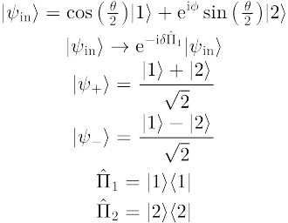
Weak values from output intensities
Initial state:
Neutron Mach-Zehnder
interferometer:
Path observable:
2
1

Slide 33
Weak values from output intensities
Initial state:
Neutron Mach-Zehnder
interferometer:
Path observable:
Phase shift:

Slide 34
Weak values from output intensities
Initial state:
Neutron Mach-Zehnder
interferometer:
Path observable:
Phase shift:
-
+
Final states:

Slide 35
Weak values from output intensities
Initial state:
Neutron Mach-Zehnder
interferometer:
Path observable:
Phase shift:
Final states:
Measured intensity:

Slide 36

Weak values from output intensities
Initial state:
Neutron Mach-Zehnder
interferometer:
Path observable:
Phase shift:
Final states:
Path weak-values:
Measured intensity:

Slide 37
Weak values from output intensities
Generalized neutron
Mach-Zehnder interferometer:
Weak values can be
directly extracted from
the output intensities!
Path weak-values:

Slide 38
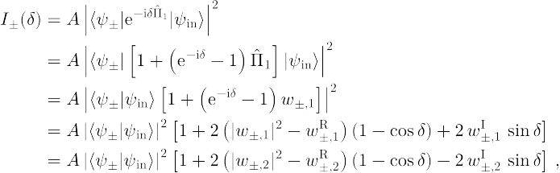
Weak values from output intensities
Measured intensity:
Amplitude
squared
Real
part
Imaginary
part

Slide 39
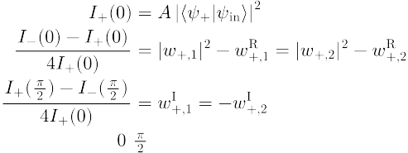

Weak values from output intensities
Three measurements settings:

Slide 40
Weak values from output intensities
Three measurements settings:

Slide 41
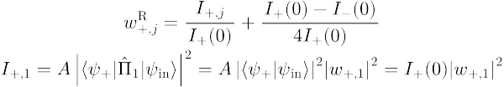
Weak values from output intensities
Three measurements settings:

Slide 42
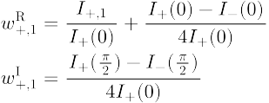
Weak values from output intensities
Three measurements settings:
Weak value extraction:

Slide 43
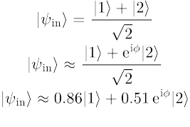
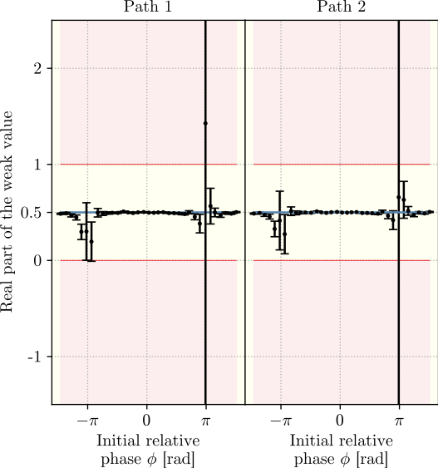
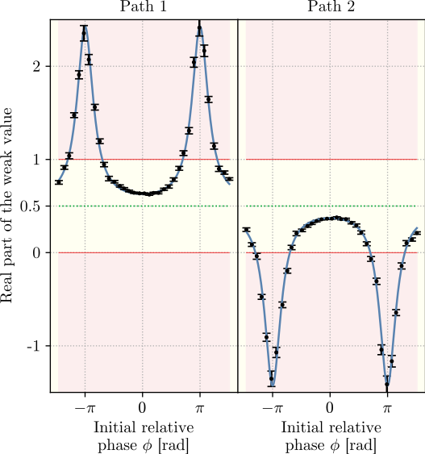
Weak values from output intensities
Balanced:
Unbalanced:

Slide 44
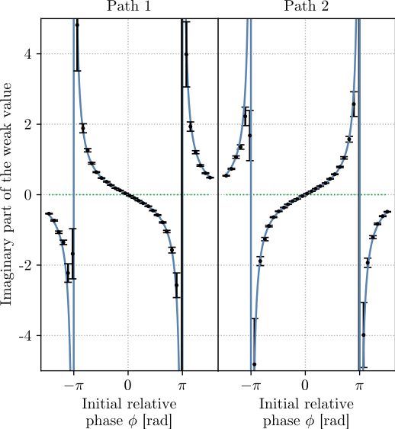
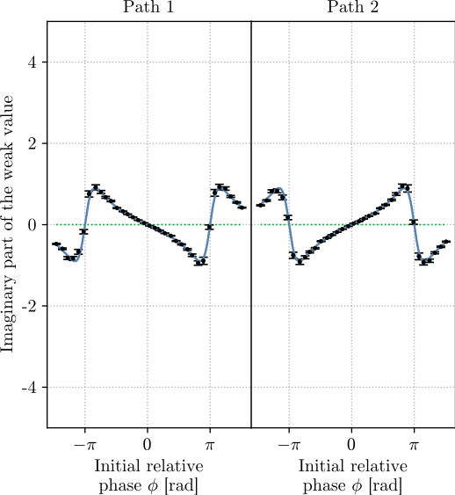
Weak values from output intensities
Balanced:
Unbalanced:

Slide 45
Weak values from output intensities
Bonus experimental result!
Three-path neutron interferometer:
3
2
1

Slide 46

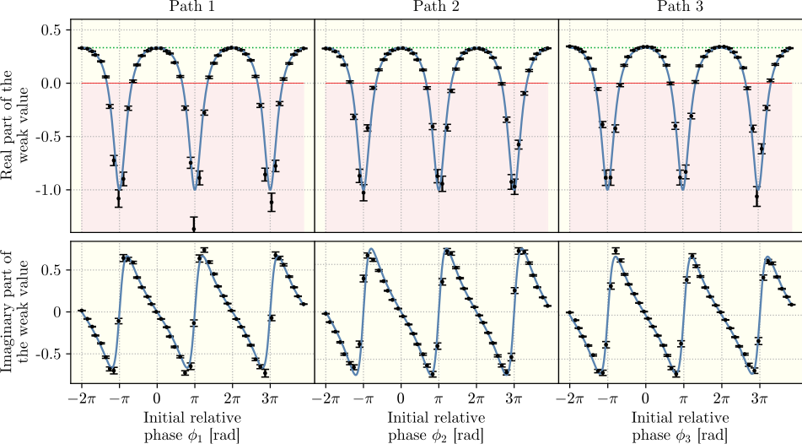
Weak values from output intensities
Initial state:

Slide 47
Summary
Weak values can be used to identify nonclassical features
Our group developed several methods to extract weak values in neutron interferometry
In particular, one method that requires no weak interaction and no meter state was presented. The method can be applied any N-level quantum system in which alike measurements can be performed.

Slide 48
Neutron Interferometry Group
Hartmut Abele
(Head of group)
Yuji Hasegawa (Professor/supervisor)
Stephan Sponar (Professor)
Hartmut Lemmel (Instrument responsible)
Andreas Dvorak (PhD student)
Florian Engel (PhD student)
Kazuma Obigane (PhD student)

Slide 49
Thank you for your attention!

